Slide 1
Machine Learning & Deep Learning
Week-11
Instructor: Engr. Najam Aziz

Slide 2
Hidden Markov Model (HMM)

Slide 3
Stochastic/Random Processes
Weather - Sunny, Rainy, Cloudy
Customer next phone - Nokia, Samsung, iPhone
Infant baby - Playing, Eating, Sleeping, Crying
Tourist city visit - A, B, C
Game Result - Lose, Draw, Win

Slide 4
Markov Model
A Markov Model is a stochastic model used to model randomly changing systems/events/states of finite number..
It is assumed that future state depends on the current state, not on the one occurred before it(i.e. past states). Event/state at time t+1 depends on t, not on t-1 - Markov Property
Markov Chain/Process: Any change of events/chain that is following the markov property is called markov chain/process.
Let {x₀, x₁, x₃, …., x_{n}} be a sequence of distinct random variables/ events. Then {x₀, x₁, x₃, …., x_{n}} is a Markov chain/process if it satisfy the markov property.
While doing Exercise, since you pick the next exercise set based on the set you’ve done before, your workout routine follows the Markov assumption. It assumes the transition probability between each state only depends on the state you are in.
A Markov chain has short-term memory, it only remembers where you are now and where you want to go next.
https://towardsdatascience.com/markov-models-and-markov-chains-explained-in-real-life-probabilistic-workout-routine-65e47b5c9a73

Slide 5
Markov Chain/Process
Type of discrete stochastic process in which the probability of an event occurring only depends on the immediately previous event.
Assumption: The underlying assumption is that the “future is independent of the past given the present”. In other words, if we know the present state or value of a system or variable, we do not need any past information to try to predict the future states or values. Markov chains are generally defined by a set of states and the transition probabilities between each state.These transition probabilities are usually represented in the form of a Matrix, called the Transition Matrix, also called the Markov Matrix. How do we calculate these probabilities? - from data.

Slide 6
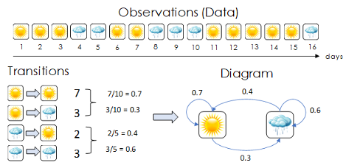
Modeling a Stochastic Process
Calculating the probabilities - Transition + Initial State Space: {Sunny , Rainy}
Initial state distribution/Probabilities:
Sunny = 10 / 16 = 0.625
Rainy = 6 / 16 = 0.375
𝜋 = { S = 0.625, R = 0.375}
 | Sunny | Rainy
Sunny | 0.7 | 0.3
Rainy | 0.4 | 0.6
State Transition Diagram

Slide 7
Example Problems
Q1: Given that today is Sunny, what is the Probability that tomorrow is Cloudy?
Sol: P(Cloudy / Sunny) = 0.05 - From transition probability matrix
Q2: Given that today is Sunny, what is the probability that tomorrow is Sunny, and day after is Raining?
Sol: P( R₃/S₂) * P(S₂/S₁) = 0.15 * 0.8 = 0.12 = 12%
General Rule: P(t₁, t₂, … , t_{n}) = 𝚷_{i=1}^{n} P( t_{i} / t_{i-1})
Q3: Given that today is Cloudy and yesterday was Raining. What is the probability that tomorrow would be Sunny?
Sol: P(S₃/C₂) * P(C₂/R₁) = 0.75*0.02=0.015=1.5%
Q4: What is the Probability of given series? S - R - R - R - C - C
Sol: P(S₁)*P(R₂/S₁)*P(R₃/R₂)*P(R₄/R₃)*P(C₅/R₄)*P(C₆/C₅) P(S₁) - initial state doesn’t depend on anyone. So its P(S)
We have Weather Historical Data.
State Space: { Sunny = S, Rainy = R, Cloudy = C}
States initial Probabilities: { 0.7, 0.25, 0.05 }
States Transition Probabilities:
 | S | R | C
S | 0.8 | 0.15 | 0.05
R | 0.38 | 0.6 | 0.02
C | 0.75 | 0.05 | 0.2

Slide 8
Hidden Markov Model (HMM)
In many cases, the events we are interested in might be not directly observable, but hidden. Instead, we have some evidence/observation for them.
E.g. Sitting in room and seeing a person entered with umbrella.
HMM model such events where states itself are hidden, but have some evidence as visible states.
Hidden Markov Process: A markov process where the states we are interested in are hidden themselves and have observation as evidence, are called Hidden markov process.
HMM models such processes.
Generally used in predicting states (hidden) using sequential data like weather, text, speech etc.
The hidden states form a Markov chain, and the probability distribution of the observed symbol depends on the underlying state.
Hidden Markov Models in general (both supervised and unsupervised) are heavily applied to model sequences of data.

Slide 9
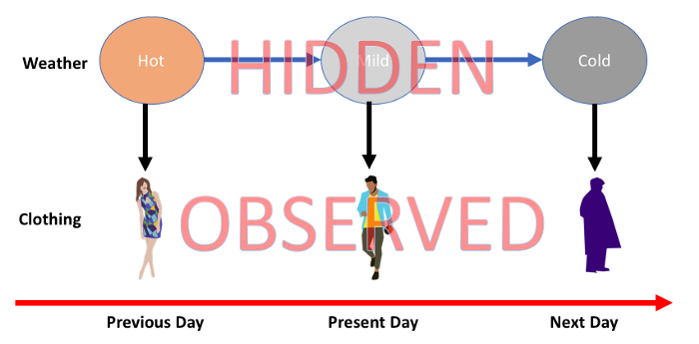

Slide 10
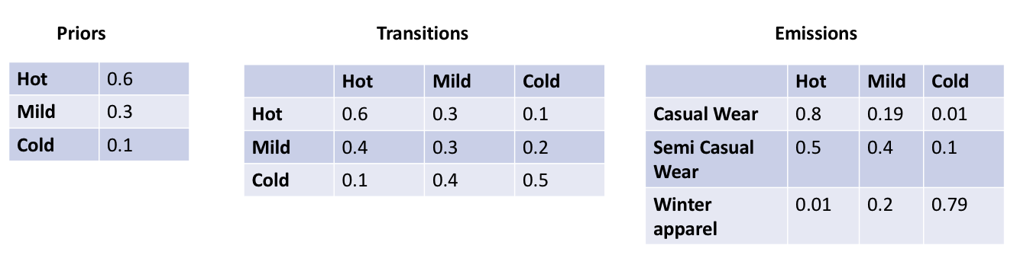
Modeling a Hidden Markov Process
To model a hidden markov process, we need to have
States: Hidden, Observable
Probabilities: Initial/Prior, Transition, Emission
Initial: Hidden states prior probabilities - From data/history Transition: State to State Emission: State to Observation/Evidence

Slide 11
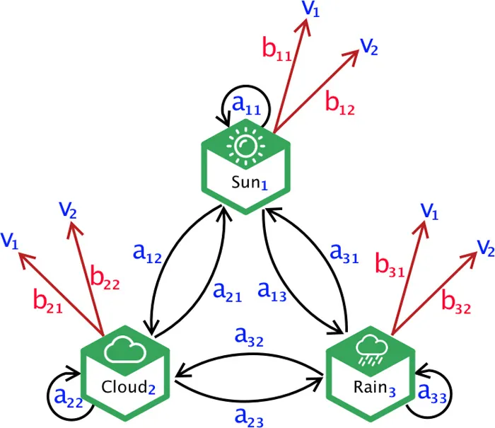
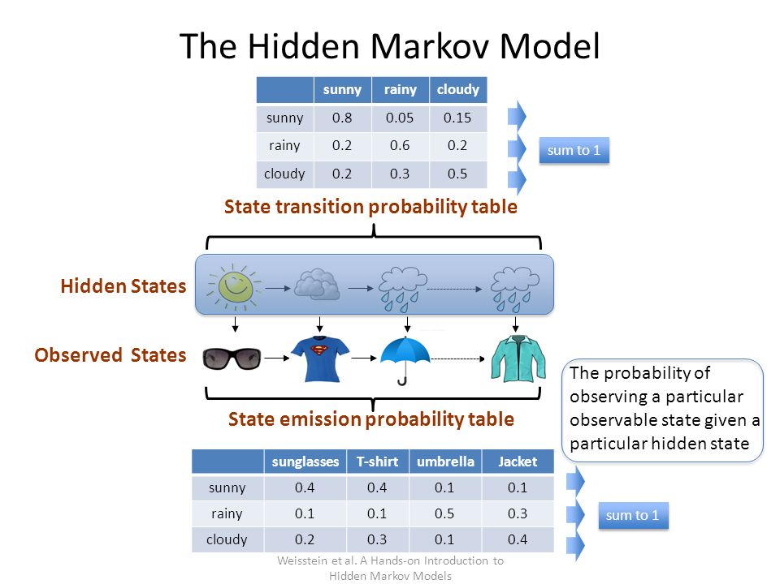
State diagram with emission probabilities

Slide 12
Three Fundamental Problems of HMM
Hidden Markov Models should be characterized by three fundamental problems: Problem 1 (Likelihood/Evaluation): Given an HMM λ = (𝜋, A,B) and an observation sequence O, determine the likelihood P(O|λ).
Problem 2 (Decoding): Given an observation sequence O and an HMM λ =
(𝜋, A,B), discover the best hidden state sequence Q.
Problem 3 (Learning): Given an observation sequence O and the set of states
in the HMM, learn the HMM parameters 𝜋, A and B.
Notes:
Lambda = initial, transition, and emission.
Problem:1 - Find the likelihood of the sequence of observations.
Problem:2 – Find the best hidden state on the basis of given sequence of observation.
Problem:3 – Find the initial, transmission, emission on the basis of given sequence of observation and best hidden state.

Slide 13
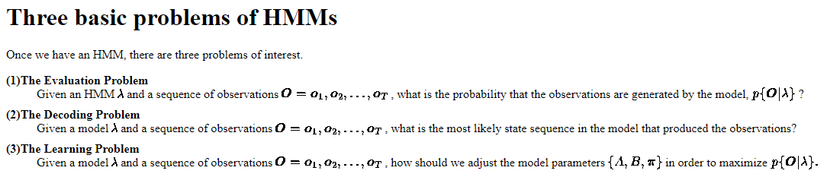

Slide 14
Example Problem - (Decoding)
We are observing a person entering a room while wearing {Coat, Coat, Umbrella} for three consecutive days, Find the hidden weather sequence for these three days? Given that: State Space: {Sunny, Rainy, Cloudy} Observation/Evidence Space: {Short, Coat, Umbrella} 𝜋 = { S = 0.75, R = 0.2, C = 0.05}
A = B =
Complexity : No of Possible state sequence= M = N^{T}
Where N = No of Hidden States
T = No of Observations given in question = 3
(Coat, Coat, Umbrella) are 3 observation over 3 Days
 | S | R | C
S | 0.8 | 0.15 | 0.05
R | 0.38 | 0.6 | 0.02
C | 0.75 | 0.05 | 0.2
 | Short | Coat | Umb
Sunny | 0.6 | 0.3 | 0.1
Rainy | 0.05 | 0.30 | 0.65
Cloudy | 0 | 0.5 | 0.5

Slide 15
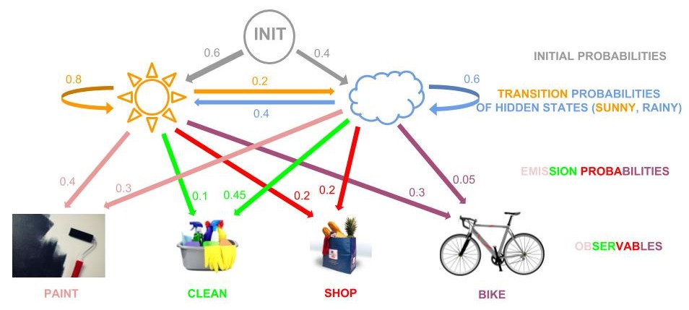
Example Problem-1 (Evaluation/Likelihood Problem: Forward-Backward Algorithm
Lea is our imaginary friend and during the day she does either of these four things: Painting, Cleaning the house, Biking, Shopping for groceries

Slide 16
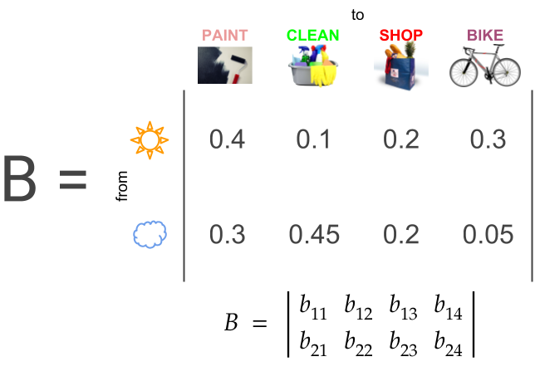
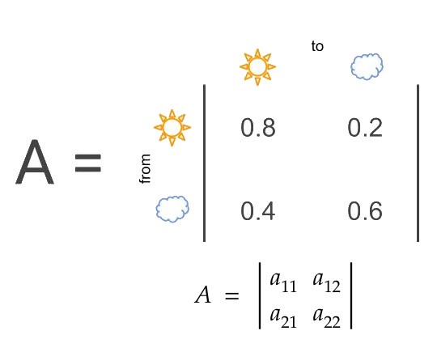
Transition & Emission Probabilities

Slide 17
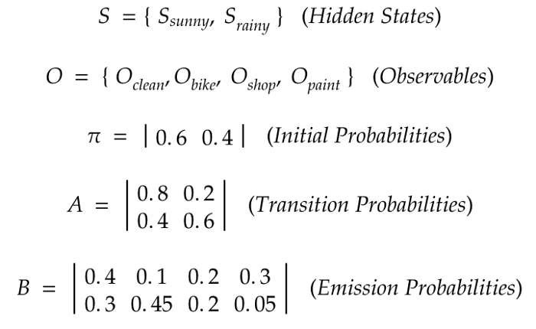

Slide 18

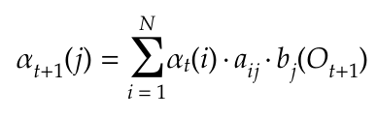
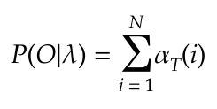
Forward Algorithm - 3 Steps
what is the likelihood that this observation sequence O can derive from our HMM λ?
P(O|λ) = ???
There are two methods with which we can calculate this: the Forward Algorithm and the Backward Algorithm.
Initialization
First forward variable
Recursion
Finding the next Forward variable
Termination
Sum up all the forward variables at time T, i.e. all the variables of every state at the end of the observation sequence.

Slide 19
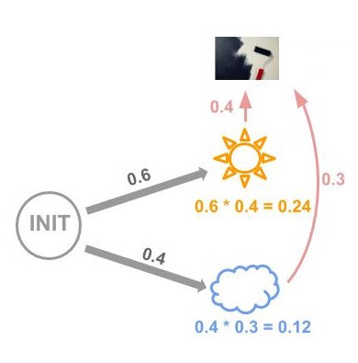
Initialization:
The above equation means that the first forward variable is calculated by multiplying the initial probability of state i by the emission probability b of that state given the observable O at time 1.
As can be seen the initial forward variable of the Sunny state is the initial probability of Sunny, 0.6, times the emission probability from Sunny to the observable Paint, 0.4. Hence, 0.24.
While the initial forward variable of the Rainy state is the initial probability of Rainy, 0.4, times the emission probability from Rainy to the observable Paint, 0.3. Hence, 0.12.

Slide 20
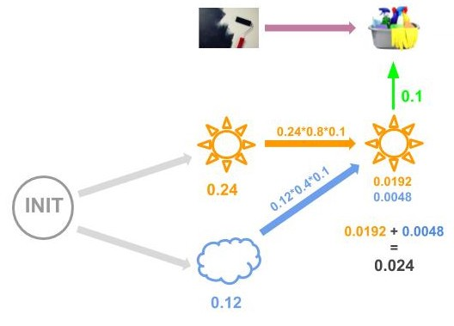
Recursion:
For t = 1, 2, …, T-1 we make use of the recursion equation which defines the forward variable of state j as the product of the previous forward variable of state i, multiplied by the transition probability a between the previous state i to state j, multiplied by the emission probability b from state j to the observable O.
Here we are calculating the forward variable of state Sunny at time 2 by summing the results of two multiplications:

Slide 21
The previous forward variable of the previous Sunny state, 0.24, times the transition probability from Sunny to Sunny, 0.8, times the emission probability from Sunny to Clean, 0.1. 0.24 * 0.8 * 0.1 = 0.0192
The previous forward variable of the previous Rainy state, 0.12, times the transition probability from Rainy to Sunny, 0.4, times the emission probability from Sunny to Clean, 0.1.
0.12 * 0.4 * 0.1 = 0.0048
Then, according to the equation above, we sum these results and get our forward variable.
α = 0.0192 +0.0048 = 0.024

Slide 22
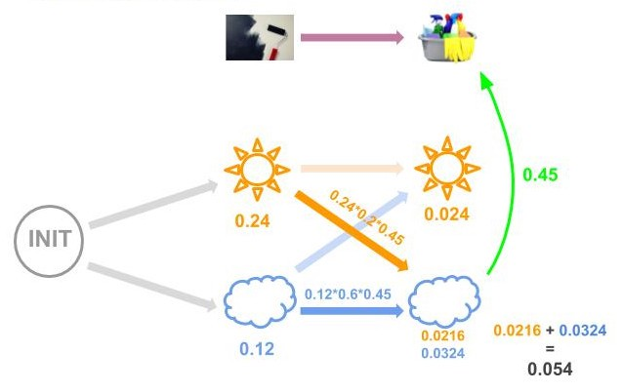
Similarly, for the next step we’ll have a forward variable of 0.054 for the Rainy state:

Slide 23
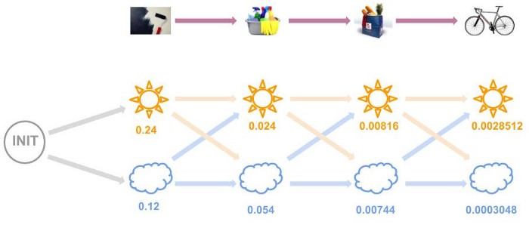
And so on until we have all the forward variables:

Slide 24
Termination:
This final equation tells us that to find the probability of an observation sequence O deriving from an HMM model λ, we need to sum up all the forward variables at time T, i.e. all the variables of every state at the end of the observation sequence. Hence, in our example above,
P(O|λ) = 0.0028512 + 0.0003048 = 0.003156
Hence, we can say that the probability that Lea has spent the last four days painting, cleaning, shopping and biking, is 0.003156 given the HMM model we have built for her.

Slide 25
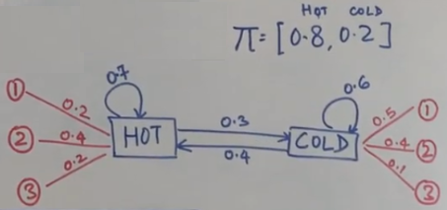
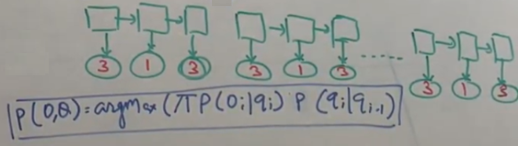
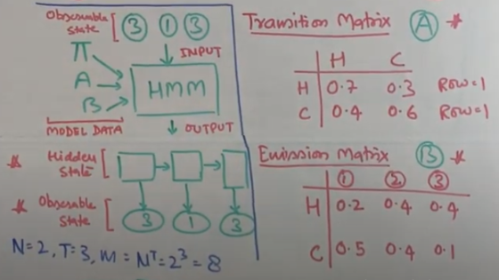
Example Problem 2 - (Decoding Problem: Viterbi Algorithm)

Slide 26
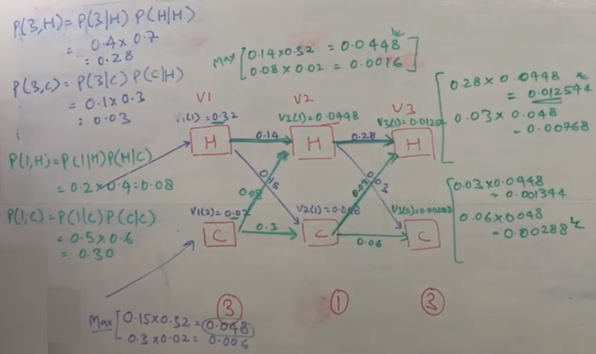
Viterbi Algorithm

Slide 27
Important Links
https://www.youtube.com/watch?v=onSi24lM47U&list=PLIRnO_sdVuEfNSksORUz5xzlI79AVtAkz
https://medium.com/@Ayra_Lux/hidden-markov-models-part-1-the-likelihood-problem-8dd1066a784e
https://medium.com/@Ayra_Lux/hidden-markov-models-part-2-the-decoding-problem-c628ba474e69

Slide 28
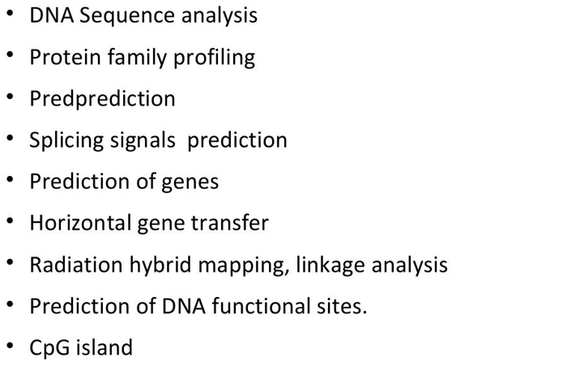
HMM Applications

Slide 29
???

